Slide 1

Fire Detection System
Team Members
Akash Patel - 100838052
Yash Patel - 100837979
Nishith Patel – 100837978
Vrushabh Shah - 100840595
Priyank Patel - 100638875

Slide 2
Problem statement
It is a web-based application system which is designed to detect fire with the help of AI Module.
Whenever it detects any fire, it will automatically send a notification via email and sms to the owner or any other authorized person.

Slide 3
Introduction
As we know, the control of wildfire has become a huge challenge by using the traditional technologies. On the other hand, recently, the advancement in technology and especially the machine learning have benefited the society a lot in diverse aspects, ranging from self driving car to cancer research.

Slide 4
Hence, it can surely contribute to the technology to early detect the fire so that we can react it earlier before getting it worse and making a lots of damage or being it out of control. We can train a deep neural network to distinguish fire and non-fire situation with very good accuracy.
This technology aided with suitable hardware design can be vary useful to minimize the fire hazard. In this work we train a convolutional neural network which can achieve out of sample accuracy of 97% classifying the fire and non-fire images.

Slide 5
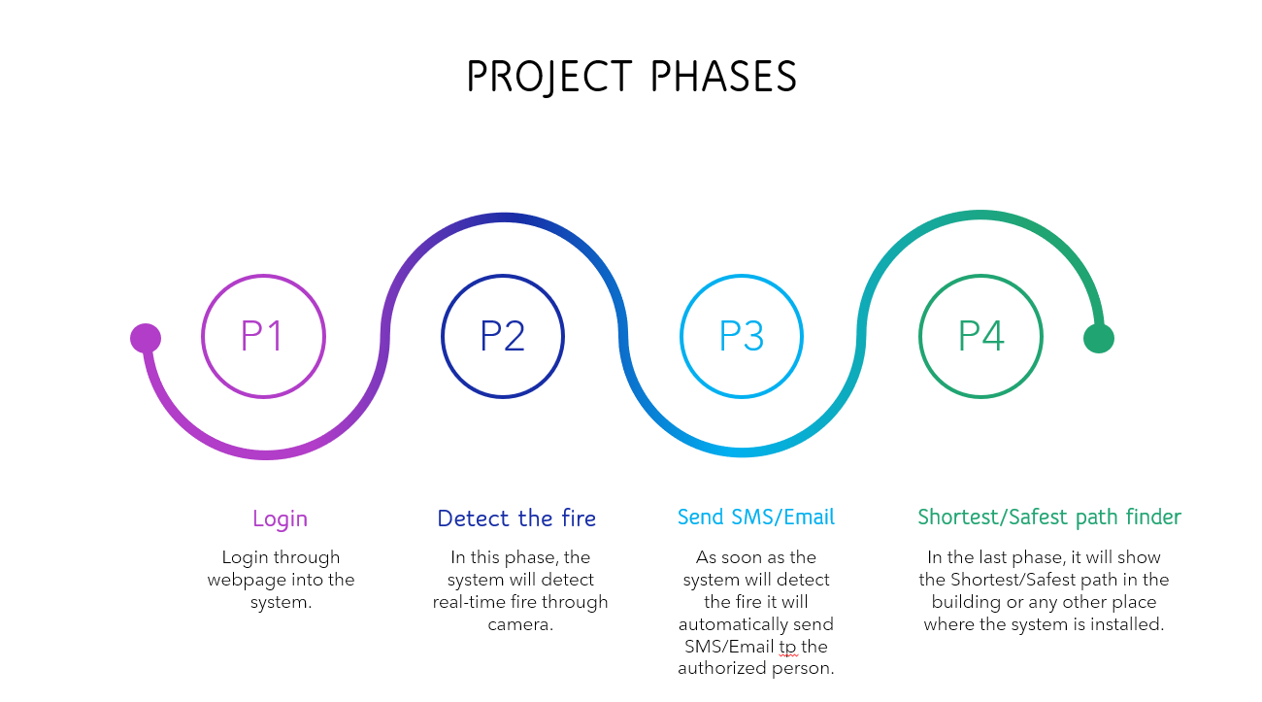

Slide 6
Why are fire detection and alarm systems required?
Detect fire in the areas.
Notify building occupants to take evasive action to escape the dangers of a hostile fire.
Summon organized assistance to initiate or assist in fire control activities.
Initiate automatic fire control & suppression systems & to sound alarm.
Supervise fire control & suppression systems to assure operational status is maintained Initiate auxiliary functions involving environmental, utility & process controls.

Slide 7
Future scope
In the future, we can enlarge the database of system to help the people who are in emergency.
For example, the system will automatically warn the nearest fire department and police officer through the GPS and it will send exact location or address of the place to them.
Moreover, we can also install alarms and sprinklers to the existing system to reduce the chances of hazardous accident and to aware people around that particular area.

Slide 8
Conclusions
This system proposed a real-time and embedded implementation of a fire detection technique that can reuse standard video cameras of surveillance systems. The target of this work is to develop smart IoT devices for fire detection in indoor and outdoor environments. The algorithm is simple to design and can be trained fast. The proposed solution achieved promising results for accuracy in comparison to the state-of-the-art. In terms of false positive, it reduced the background mistakes in non-fire videos.
The proposed detection solution stands for its low-latency and real-time performance when compared to the other regional-based detectors. Indeed, it can detect fire in 1 or 2 s as an early alerting alarm for the occurrence of fire and smoke accidents. In the future, we will extend our research to connect the proposed system to iCloud facilities for providing visual status and feedback of fire remotely.

Slide 9
Thank you

